Slide 1
Introduction to alcohol and other drugs and how to talk about it

Slide 2

Introduction to Tūturu
Watch on youtube ⟶

Slide 3

Outline
The context in Aotearoa
Protective factors, connection and long-term patterns
Relevant factors about alcohol and other drugs
What we can all do
Notes:
Outline that this workshop will: cover the Aotearoa/NZ context for young people and substances; explore protective factors, connection and the development of longer term patterns; and highlight relevant facts about three substances.
Explain that as we work through the different slides and activities, we may remember situations that have happened to us or people around us in our own lives. Some of the information in this presentation reflects our new knowledge about alcohol and other drugs and what effective messages are, which may appear different to what we have been told before. We are happy to talk to people afterwards to clarify or provide extra information as needed.

Slide 4
The context in Aotearoa

Slide 5
People learn through progressive exposure to new ideas or skills
But alcohol and other drugs are commonly treated differently.
Identify
It’s harmful, don’t do it
Raise it as a problem
It’s harmful, don’t do it
Recall
Explore strategies
Understand
This gap is filled with learning from experience, movies, myths, fear.
Shift seats
Apply
Discuss with parents
Compare & contrast
Monitor progress
Critique
Notes:
Explain that we know that people learn through progressive exposure to new ideas or skills, but that alcohol and other drugs are commonly treated differently. An example to highlight this is how we teach skills in many other subject areas.
This could follow a pattern of: identifying a concept; recalling it; understanding it; applying it; comparing and contrasting it; and critiqueing it. However, when we teach about alcohol and other drugs, we used to believe that a “it’s harmful, don’t do it” approach would work.
For some reason even though we know about effective pedagogy, we don’t apply it when it comes to alcohol and other drugs.
The same can apply to coaching around behaviour. If we picture a young person who struggles to pay attention in class, we might follow a pattern of: raising it as a problem; exploring strategies; shifting their seats in class; discussing it with their parents; and monitoring progress. However, with alcohol and other drugs, we commonly bypass those steps and use an “it’s harmful, don’t do it approach.”
Again, for some reason we are not applying what we know works. And the problem is that this gap in learning is filled with what an individual learns from experience, movies, myths, social media, friends and fear. That is highly varied between people. We now know that the “drugs are bad, just say no” approaches do not work, and it is time to move past the moral panic and utilise our knowledge and skills about what does work for effective teaching.

Slide 6

Our morals
Rank the scenarios from one (least bad) to six (worst)
A teacher drinks a bottle of merlot on a Sunday night (into the early hours) and comes to school on Monday morning still feeling tipsy and smelling of alcohol.
A student leaves alcohol and drug counselling and has a few beers to celebrate achieving their goals that they set last week.
A
B
A student buys cannabis on their way to school and has it in their bag, intending to smoke it on the weekend.
C
D
E
A student uses methamphetamine once at home on the weekend.
F
A group of parents who are helping on a four-day school trip bring alcohol for them to drink when the students are sleeping.
A father asks their child to sell cannabis to their friends to help the family earn money.
Notes:
Explain that we have all been exposed to the “drugs are bad, just say no” approach, and in the first part of this workshop, we are going to look at our own opinions about alcohol and other drugs.
. This slide has six different scenarios that are relevant to a school environment. Read these scenarios out loud and ask each attendee to reflect on these and rank them from one (less bad) to six (more bad). Give each attendee the worksheet so they can write their rankings down.
After they have done this, explain that you will read out each scenario again and ask everyone at the same time to put their hands up showing what rank they gave that scenario with the number of fingers they are holding up.
Read each scenario and ask each group member to hold up their hands with the number of fingers representing the ranking they gave that scenario from one to six. Once they have done that, reflect back to the group that the group had a range from x to y (e.g. “in this room, we range from one to six”). Hint: The majority of groups have very wide ranges for most of the scenarios. 7. Reflect to the group that even in this room, which contains people who work with a lot of teenagers and probably overall have similar morals, that there is a wide range of views around what is better or worse than others. These different opinions can lead to many different messages being given to students, adding to the confusion they may have around alcohol and other drugs

Slide 7

Move past the moral panic and ask what is important to the young person.
Notes:
Explain that we can help students by moving past the moral panic to focus on what will give students the best opportunities for success in a modern world where alcohol and other drugs exist.

Slide 8
The statistics

Slide 9
Is substance use a normal part of adolescent development?
Every
Many
Some
A few
Every young person will decide whether they will use substances or not. Some will revisit this decision many times.
Many young people will try substances.
Some young people will use substances regularly, with some short-term harms.
A few young people will use substances regularly, and potentially develop long-term harm patterns and associated harms.
23% of secondary school students said that they had tried cannabis. (Youth 2019)

Slide 10
Alcohol as an example
Out of every ten secondary school students aged 17 years or over:
10 would have decided whether to drink alcohol or not
8 would have tried alcohol
2 would have experienced an alcohol-related injury
1 would have had friends or family members tell them to cut down
Every
Many
Some
A few
Based on Youth 2012 data

Slide 11
The continuum of substance use
Most people who use substances are not dependent on them
No use
Experimental
Recreational
Regular use
Dependence
The Continuum of Substance Use (adapted from Winchester, Kelly & Sander, 2004)

Slide 12
The rates are going down and other drug use is uncommon
Students who binge drank monthly or more often
Students who used cannabis weekly or more often
Students who smoked cigarettes weekly or more often
Students who smoked a vape weekly or more often
40
10
30
30
34%
36%
25%
7%
20
22%
5%
15
15%
15
10
4%
4%
8%
5%
6%
0
0
0
2%
0
2001
2007
2012
2019
2001
2007
2012
2019
2001
2007
2012
2019
2019
Alcohol
Cannabis
Cigarettes
Vaping
Notes:
Explain that the rates of substance use among secondary school students is reducing and other drug use is uncommon. law around drugs does not reflect their levels of harm. For example, alcohol is more harmful than cannabis despite it being legal and cannabis being illegal.

Slide 13

Vaping statistics
42.7%
9.6%
3%
of year 10 students have tried vaping
of year 10 students vape daily
of year 10 students that had never smoked tobacco, now vape daily
Keep in mind that cigarettes are about 95% more harmful than vapes.
Independent Scientific Committee on Drugs, 2014

Slide 14
Although use of alcohol and other drugs at harmful levels is rare, we still need to reach the students that use them.
11%
50%
of New Zealand secondary school students used substances at levels that were “likely to cause significant current harm and may cause long term problems.”
of the people in New Zealand who experience alcohol dependence would have developed it by the time they were 19 years of age.

Slide 15
Protective factors, connection, and long-term patterns

Slide 16

Protective and risk factors
Protective factors buffer against the effects of risk factors

Slide 17

Engage or reengage young people in supportive environments and positive activities
This can even be helpful for young people who do not want to make changes.

Slide 18
Relevant facts about alcohol and other drugs

Slide 19



What are the general risks for each category?
Or mixing between categories?
Depressants
Stimulants
Hallucinogens
Sleepy
Speedy
Trippy

Slide 20
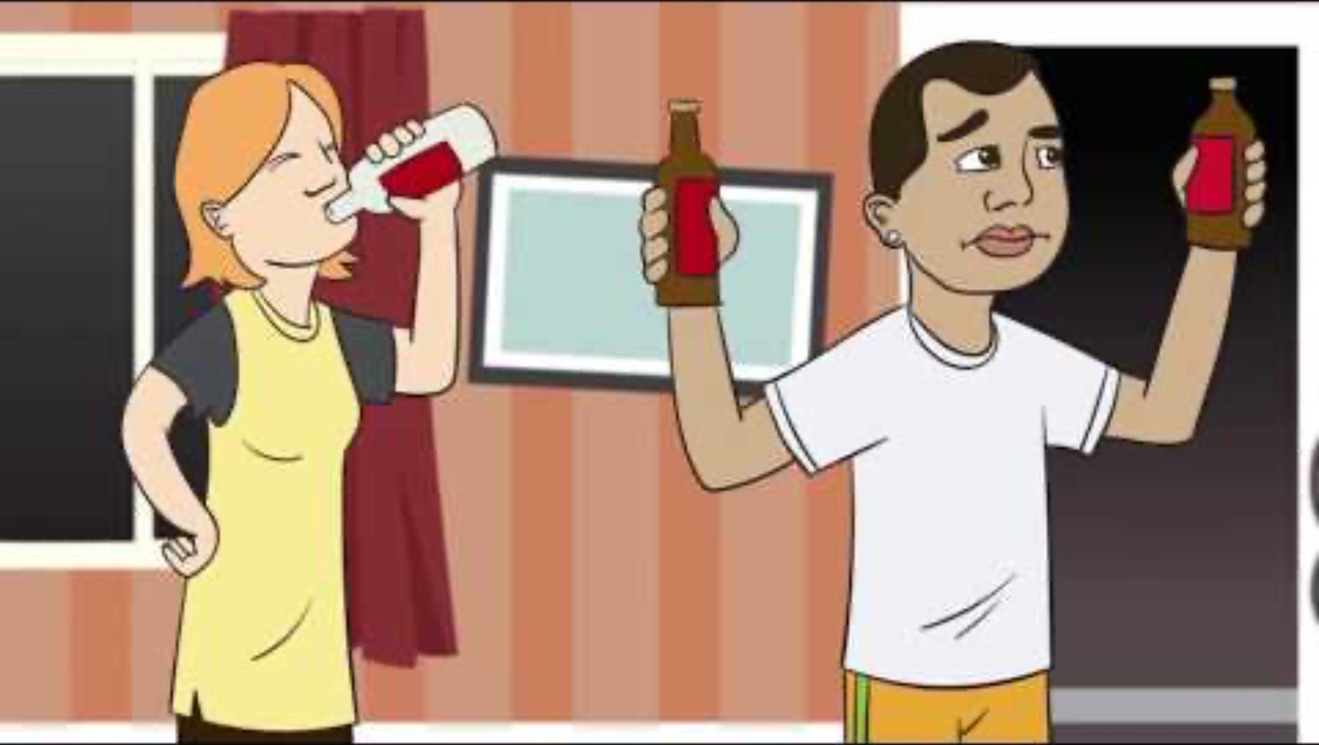
Did you know? Alcohol
Watch on youtube ⟶

Slide 21
Teenage bodies are different from adults
Or mixing between categories?
1. Relaxed and social
Teenage bodies don’t show the physical signs that too much alcohol has been drunk as much as adult bodies.
2. Loud and clumsy
3. Swaying and memory loss
Slurring, passing out and losing balance means they are way too drunk.
4. Falling over and vomiting

Slide 22

Changing safe zone boundaries
Going to multiple parties in one night with no way home
Drinking at parties, picked up by a parent
Going to a party, don’t care how they get home
Drinking at a mate’s place

Slide 23

Alcohol harm minimisation tips
Eat before drinking
Count the standard drinks
Avoid drinking will pregnant
Check you are within your safe zone
Don’t rely on physical indicators that apply to adult bodies
It takes at least one hour for one standard drink to leave a typical adult body.
It takes longer to leave a teenage body, even though there could appear to be less signs of drunkenness.

Slide 24
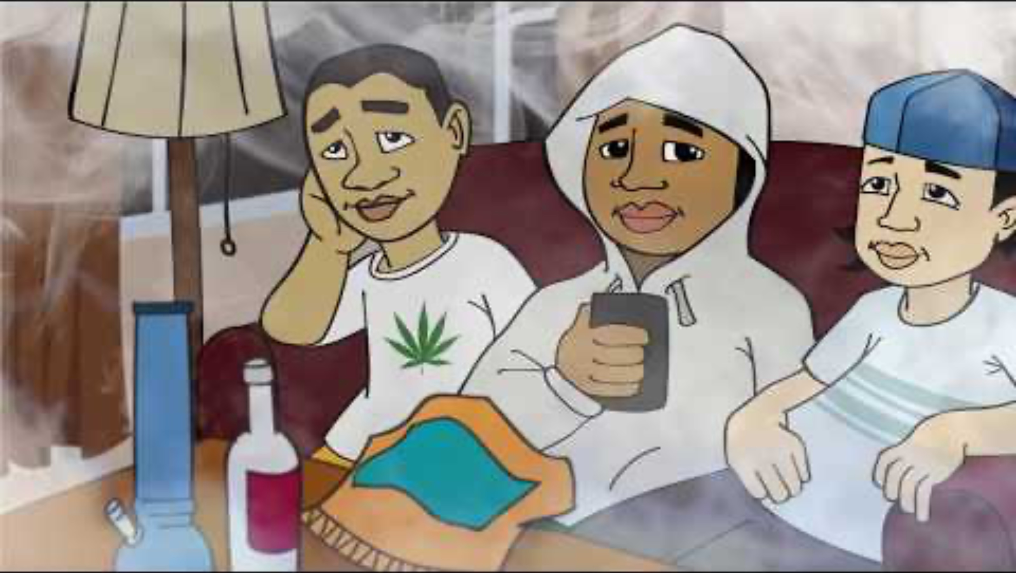
Did you know? Cannabis
Watch on youtube ⟶

Slide 25

Teenage brains are developing.
Some research indicates that while cannabis has fewer long-term risks for adults, there are potential risks for some teenagers.

Slide 26
Urine drug testing for cannabinoids is not the solution it may seem
Cut back to a session every second day
Metabolite level in urine
Cut back to a session every third day
No more use
Watch the video on youtube for more information

Slide 27
What we can all do

Slide 28

I noticed…how are things going?
Naming this is more important than the content or the outcome of a conversation.

Slide 29
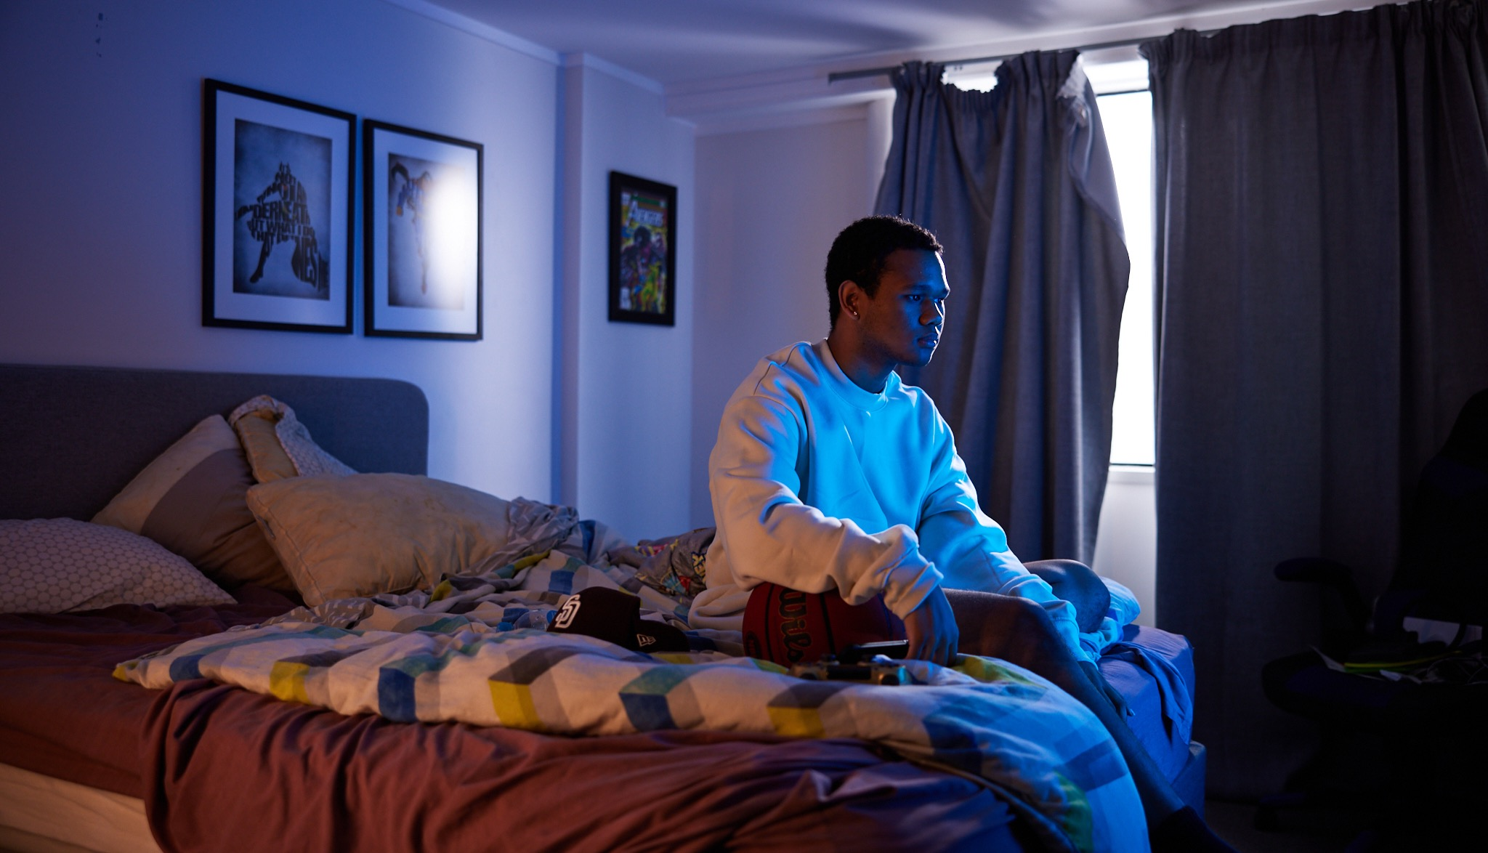
Knowing someone cares is a strong protective factor.

Slide 30
How to let a young person know you’ve noticed changes
1.
Pause and prepare to connect
2.
Use conversation starters to open up a conversation
3.
Listen.
Remember to be:
Non-judgmental
Encouraging
Compassionate
Genuine
Honest
Optimistic
Depressants
Stimulants
Hallucinogens
Sleepy
Speedy
Trippy

Slide 31
Resources
Every
Many
Some
A few
Did you know series
NZ Drug Foundation and AoD Provider Collaborative
Brief advice cards
Whāraurau/Werry Workforce, NZ Drug Foundation
The Level – Harm reduction information
NZ Drug Foundation
Substances overview table
Whāraurau/Werry Workforce, Matua Raki, NZ Drug Foundation
Bridging the Gap
Whāraurau/Werry Workforce, Matua Raki

Slide 32
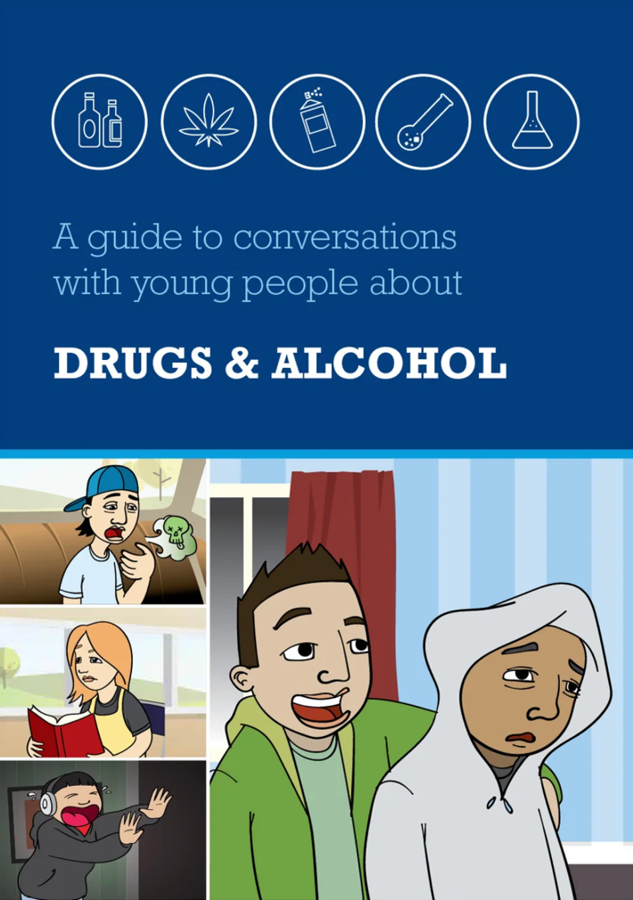
Conversation planning tool for parents
Drugfoundation.org.nz/didyouknow

Slide 33
Key points
Create a positive school environment that promotes wellbeing, student connectedness and help-seeking.
Identify students whose attendance is slipping and ask about alcohol and other drugs.
Develop critical thinking skills using real life learning contexts.
Give lots of opportunities to engage in school activities.
Offer proactive support.

Slide 34
Thank you
tuturu.org.nz

